Slide 1
Wildfire Impact in
Pueblo West, Colorado
Pueblo West is a CDP located in Pueblo County, Colorado.
Analysis of wildfire occurrences around the town from 1963 onwards.
Creation of a smoke estimate to quantify the impact of wildfire smoke in the city.
Analyzing patterns in wildfire incidents, their effects on geology, and projecting future developments.
Investigating societal consequences: Impact of smoke on respiratory health among inhabitants.
Predicting upcoming patterns and developing strategies for local government guidance.

Slide 2
Wildfire & AQI Data Acquisition
Wildfire data from US Geological Survey (1963 onwards).
The phase of data filtering and preprocessing involves the selection of fire perimeters within a 1250-mile radius of Pueblo West.
AQI Data from US Environmental Protection Agency.
Missing gaseous data in between, particulate pollutants data complete from 1987 onwards.
Smoke Impact Calculation
weight * ((fire_size)**2 / (distance))

Slide 3
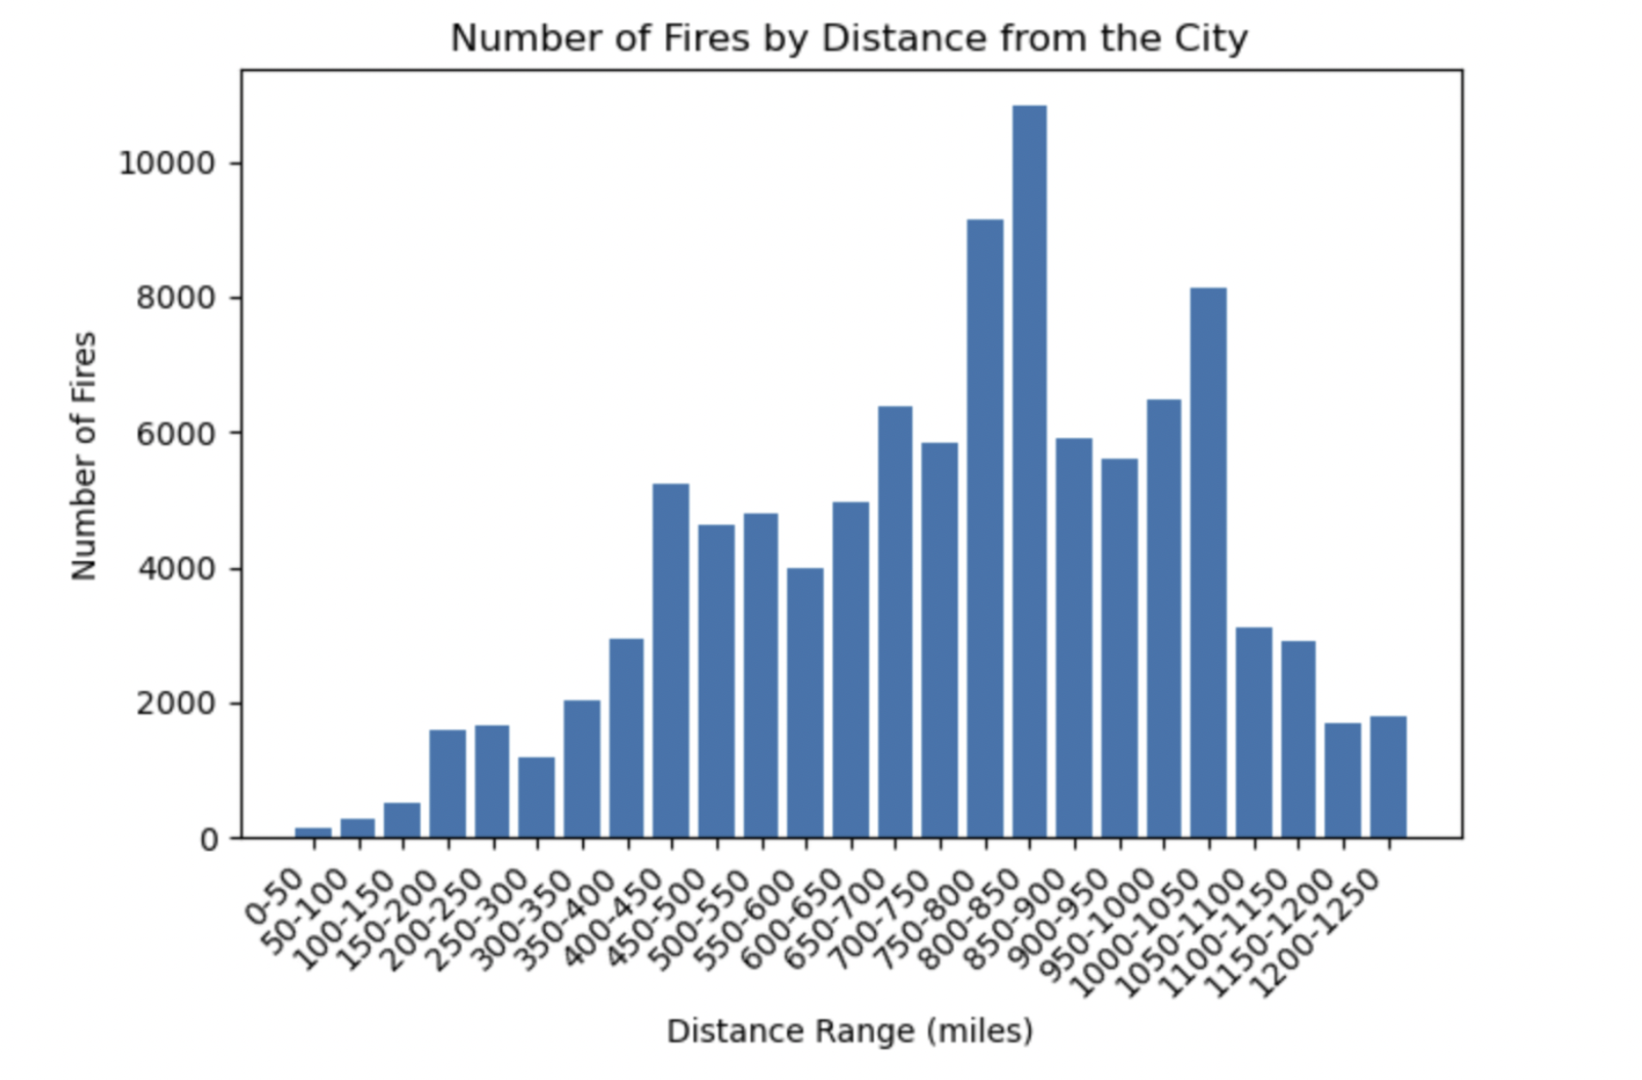
Wildfire Impact Analysis
How far from Pueblo West are wildfires occurring?
Takeaway: The majority of wildfires occur within a 800-850 mile range from Pueblo West.

Slide 4
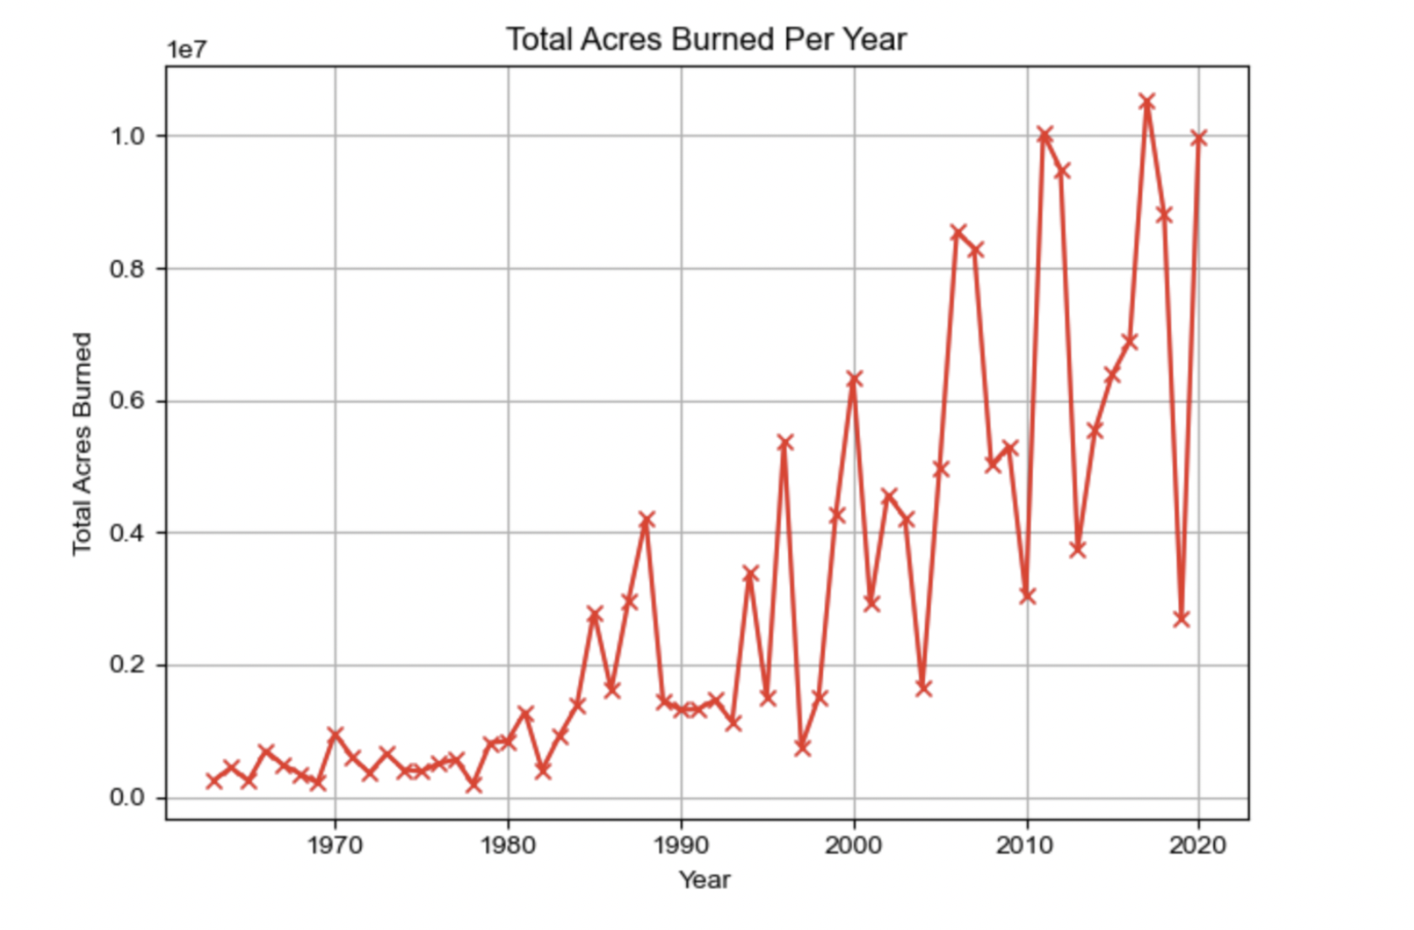
Wildfire Impact Analysis
What is the extent of land affected by wildfires?
Takeaway: Wildfires have markedly increased in frequency and intensity since the 1980s, with significant spikes in land area burned in recent years.

Slide 5
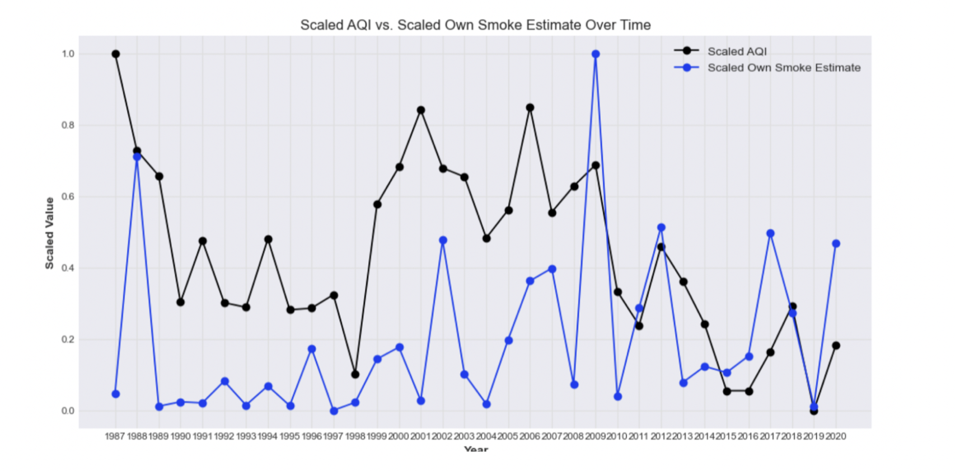
Wildfire Impact Analysis
How does smoke impact correlate with Air Quality Index?
Takeaway:: The Air Quality Index (AQI) and own smoke estimates generally show similar trends, suggesting that when smoke estimates are high, air quality tends to be poorer.

Slide 6
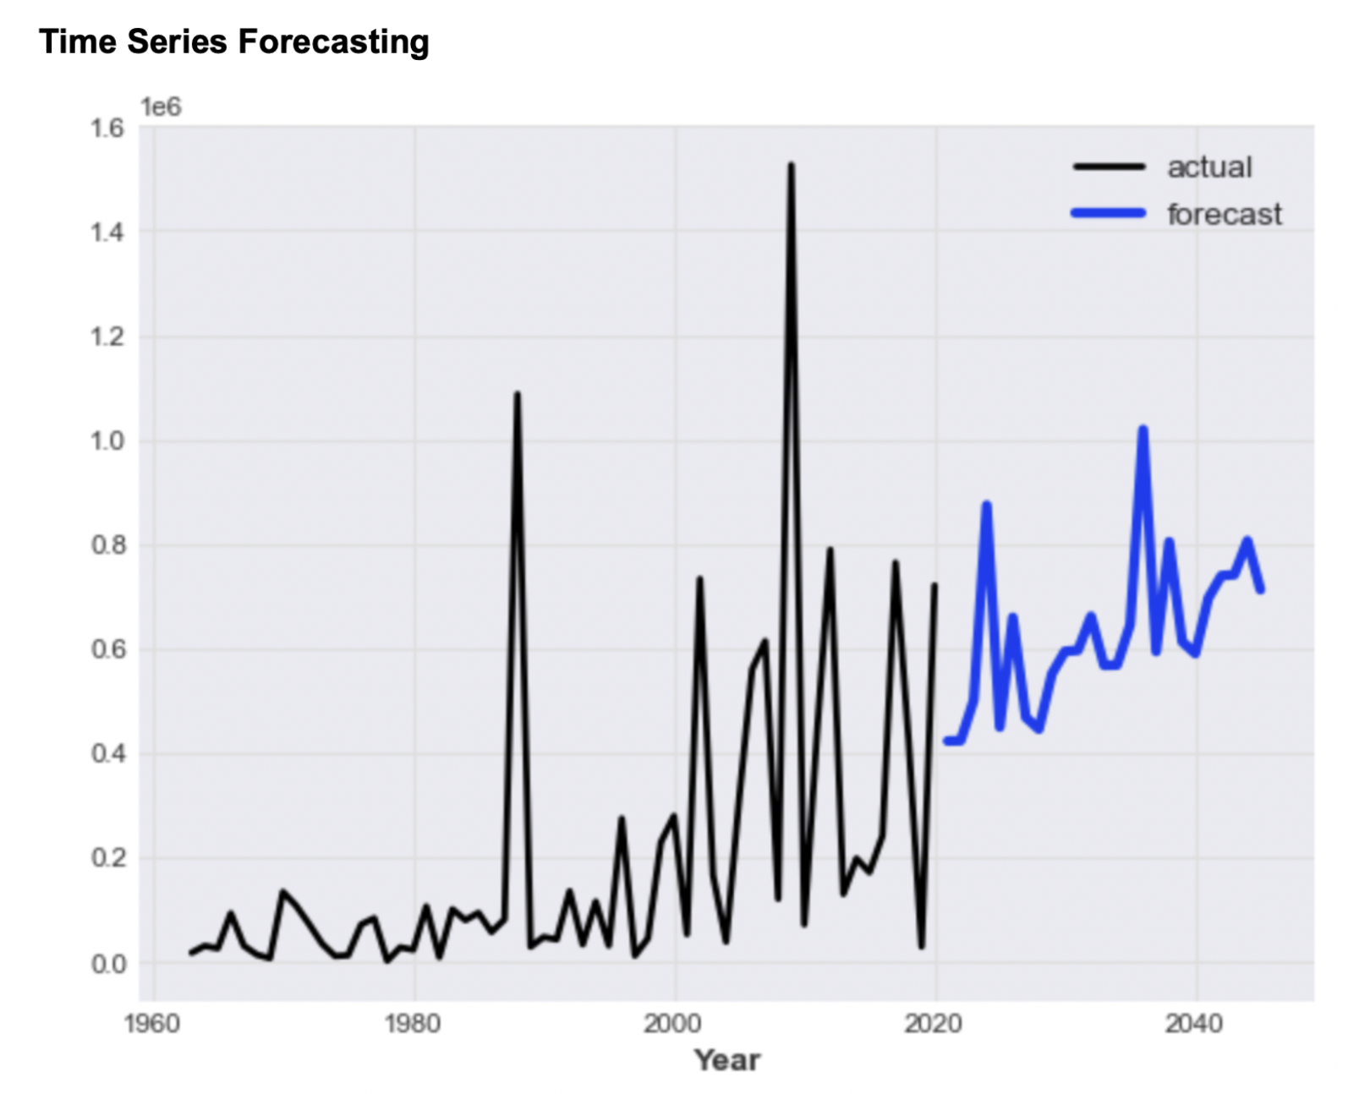
Wildfire Impact Forecasting
What could the smoke impact in future years look like?
Takeaway: The forecast suggests that the impact of smoke from wildfires is expected to continue with fluctuations, potentially indicating variable but persistent wildfire activity in the future.

Slide 7
Sociological Impacts of Wildfire: healthcare
Analyzing healthcare data in Pueblo West County, CO
My specific focus is on examining data related to Asthma.
The goal is to better understand how smoke affects the community.
Asthma and heart attacks are directly influenced by air quality.
These conditions can serve as tangible indicators of the health consequences of smoke exposure.
I aim to establish a clear connection between periods of increased smoke and the occurrences of respiratory and cardiovascular issues.
Through this analysis, I intend to provide quantitative measures of the health impacts experienced by residents.
This research will not only help us grasp the immediate effects of smoke but also provide valuable insights for developing targeted healthcare interventions.
Ultimately, it will contribute to the creation of effective public health strategies to mitigate the impact of environmental factors on the community's well-being.

Slide 8
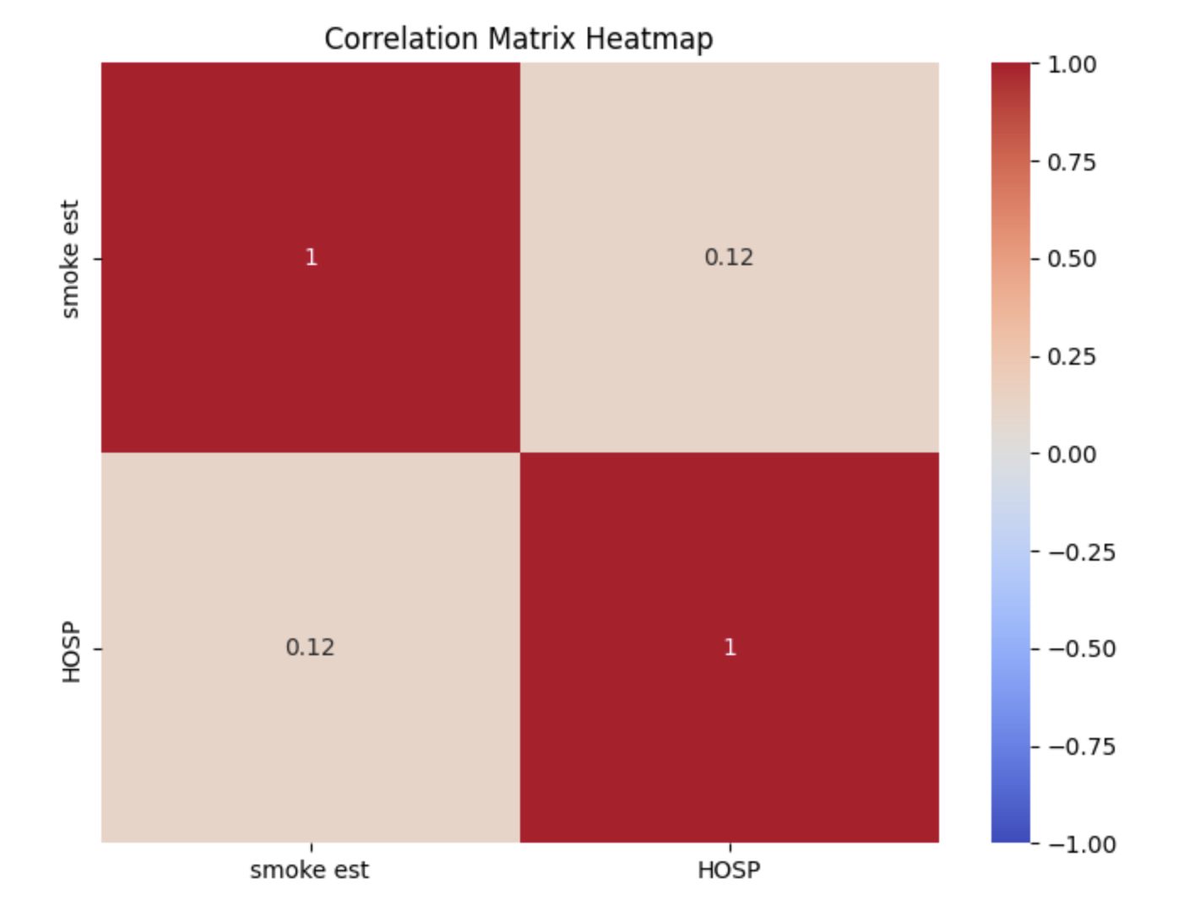
Correlation b/w Hospitalizations due to asthma and smoke estimates for Pueblo County for 2004 - 2018
Takeaway: The heatmap indicates a low correlation (0.12) between smoke estimates and hospitalizations due to asthma in Pueblo County for 2004 - 2018, suggesting that other factors may also play a significant role in asthma hospitalizations.

Slide 9
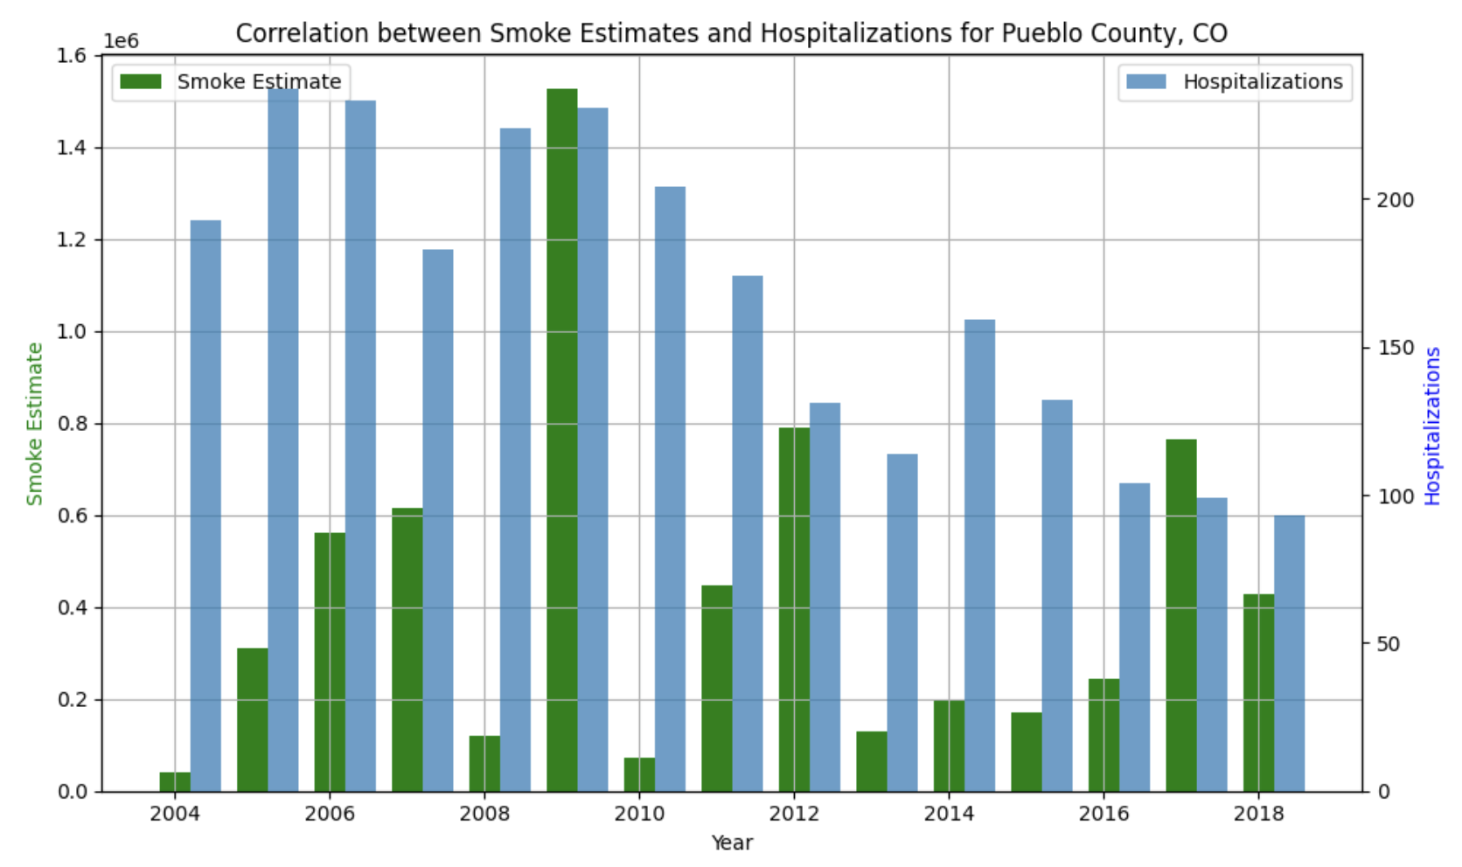
Correlation b/w Hospitalizations due to asthma and smoke estimates for Pueblo County

Slide 10
Conclusions
There seems to be a correlation between smoke estimates and asthma hospitalizations, suggesting that increased smoke exposure may be associated with more hospital visits for asthma.
The years with the highest smoke estimates, notably around 2010 and 2016, correspond to peaks in hospitalizations.
Despite some fluctuations, the overall trend indicates a potential public health issue related to air quality and respiratory health.

Slide 11
Recommendations
Implement air quality control measures, especially during periods where smoke exposure is predicted to rise, to help reduce the incidence of asthma-related hospitalizations.
Public health initiatives could include issuing warnings on days with high smoke estimates, promoting the use of air filters and masks, and advising people with respiratory issues to stay indoors.
Further research is recommended to establish a causal relationship between smoke exposure and asthma exacerbations, which could guide targeted interventions.
Regular monitoring of air quality and public health education on the risks associated with smoke exposure could help mitigate the number of hospitalizations related to asthma.

